Slide 1
Spring JMS

Slide 2
Spring JMS
JMS (Java Message Service) is a Java Message Oriented Middleware used to send messages between clients and works by sending messages to a message queue which are then taken when possible to execute a transaction. This post will focus on implementing JMS with Spring Boot, which doesn’t take long at all to setup.
JMS and message queues, in general, bring some certain advantages over using RESTful services such as:
Loose coupling: The services do not interact directly and only know where the message queue is, where one service sends messages(Publisher) and the other(Subscribers) receives them. Subscribers/Publishers can be added/removed dynamically.

Slide 3
Spring JMS
Asynchronous messaging: As the process time of the message cannot be guaranteed, the client that sent the message can carry on asynchronously to the completion of the transaction. Due to this, the queue should be used to write data (POST if you're thinking in a RESTful mindset).
Redundancy: A message must confirm that it has completed its transaction and that it can now be removed from the queue, but if the transaction fails it can be reprocessed. The messages can also be stored in a database allowing them to continue later on even if the server stops.

Slide 4
Spring JMS
Pom.xml Dependencies
<dependency>
<groupId>org.springframework.boot</groupId>
<artifactId>spring-boot-starter-activemq</artifactId>
</dependency>
<dependency>
<groupId>com.fasterxml.jackson.core</groupId>
<artifactId>jackson-databind</artifactId>
</dependency>
dependency>
<groupId>org.json</groupId>
<artifactId>json</artifactId>
</dependency>
Publisher
//Get JMS template bean reference
JmsTemplate jmsTemplate = context.getBean(JmsTemplate.class);
// Send a message
System.out.println("Sending a message.");
jmsTemplate.convertAndSend("jms.message.endpoint", new Message(1001L, "test body", new Date()));

Slide 5
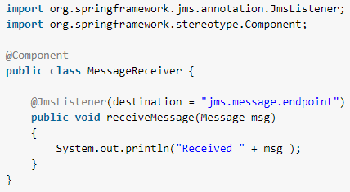
Spring JMS
Subscriber: JMS Message Receiver with @JmsListener
Message receiver class ispretty much simple class with single method with annotation @JmsListener. @JmsListener allows you to expose a method of a managed bean as a JMS listener endpoint.
So whenever any message is available on configured queue (in this example queue name is “jms.message.endpoint”), annotated method (i.e. receiveMessage) will be invoked.

Slide 6
Spring JMS Configurations
application.properties file
jsa.activemq.broker.url=tcp://localhost:61616
jsa.activemq.borker.username=admin
jsa.activemq.borker.password=admin
jsa.activemq.topic=jsa-topic

Slide 7
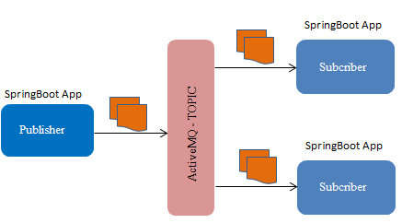
Spring Boot JMS
ActiveMq provides the Publish-Subscribe pattern (pub-sub) for building Jms message distributed systems. How it work? -> When you publish a messages, all active subscribers will receive a copy of the message.
Home page of ActiveMQ - http://activemq.apache.org/
Any Language/Platform
Any Language/Platform

Slide 8
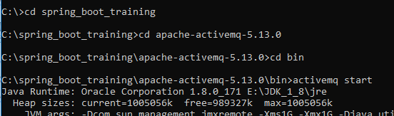

Spring Boot JMS
Download and install ActiveMQ from URL http://activemq.apache.org/activemq-5130-release.html
After downloading ActiveMQ, you can start ActiveMQ, as below
Once ActiveMQ is started successfully, open the ActiveMQ Admin URL http://localhost:8161/admin/
You can access Subscribers from its tab

Slide 9
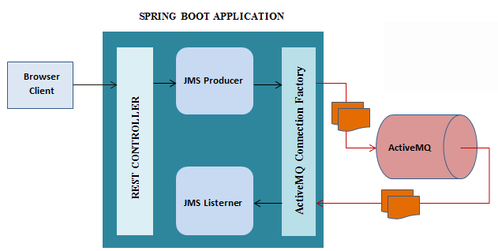
ActiveMQ with REST

Slide 10
ActiveMQ
RabbitMQ, Kafka, and ActiveMQ are all messaging technologies used to provide asynchronous communication and decouple processes (detaching the sender and receiver of a message). They are called message queues, message brokers, or messaging tools. RabbitMQ, Kafka, and ActiveMQ all serve the same basic purpose, but can go about their jobs differently. Kafka is a high-throughput distributed messaging system. RabbitMQ is an AMQP based reliable message broker. ActiveMQ and Kafka are both Apache products, and both written in Java; RabbitMQ is written in Erlang.
Apache ActiveMQ is fast, supports many Cross Language Clients and Protocols, comes with easy to use Enterprise Integration Patterns and many advanced features while fully supporting JMS 1.1 and J2EE 1.4. Apache ActiveMQ is released under the Apache 2.0 License.
Kafka is a distributed, partitioned, replicated commit log service. It provides the functionality of a messaging system, but with a unique design.

Slide 11
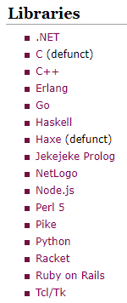
ActiveMQ – Cross Language Clients
Apache ActiveMQ is a message broker written in Java with JMS, REST and WebSocket interfaces, however it supports protocols like AMQP, MQTT, OpenWire and STOMP that can be used by applications in different languages.
Examples on how to use Publishers/Subscribers of different Languages:
http://activemq.apache.org/cross-language-clients.html

Slide 12
Characteristics of Topic
A JMS topic is the type of destination in a 1-to-many model of distribution.
The same published message is received by all consuming subscribers.
You can also call this the 'broadcast' model.
You can think of a topic as the equivalent of a Subject in an Observer design pattern for distributed computing.
Some JMS providers efficiently choose to implement this as UDP instead of TCP.
For topic's the message delivery is 'fire-and-forget' - if no one listens, the message just disappears.
If that's not what you want, you can use 'durable subscriptions'.

Slide 13
Characteristics of Queue
A JMS queue is a 1-to-1 destination of messages.
The message is received by only one of the consuming receivers (please note: consistently using subscribers for 'topic client's and receivers for queue client's avoids confusion).
Messages sent to a queue are stored on disk or memory until someone picks it up or it expires.
So queues (and durable subscriptions) need some active storage management, you need to think about slow consumers.
In most environments, topics are the better choice because you can always add additional components without having to change the architecture. Added components could be monitoring, logging, analytics, etc.

Slide 14
Other Middleware Messaging Solutions
RabbitMQ, Kafka, and ActiveMQ are all messaging technologies used to provide asynchronous communication and decouple processes (detaching the sender and receiver of a message). They are called message queues, message brokers, or messaging tools. RabbitMQ, Kafka, and ActiveMQ all serve the same basic purpose, but can go about their jobs differently. Kafka is a high-throughput distributed messaging system. RabbitMQ is an AMQP based reliable message broker. ActiveMQ and Kafka are both Apache products, and both written in Java; RabbitMQ is written in Erlang.
Apache ActiveMQ is fast, supports many Cross Language Clients and Protocols, comes with easy to use Enterprise Integration Patterns and many advanced features while fully supporting JMS 1.1 and J2EE 1.4. Apache ActiveMQ is released under the Apache 2.0 License.
Kafka is a distributed, partitioned, replicated commit log service. It provides the functionality of a messaging system, but with a unique design.

Slide 15
Spring Common App Properties
https://docs.spring.io/spring-boot/docs/current/reference/html/common-application-properties.html
Spring boot common app properties
https://docs.spring.io/spring-boot/docs/1.1.6.RELEASE/reference/html/common-application-properties.html

